Slide 1

CSE- 321
Software Engineering
Lecture : 05 Software Processes
Fahad Ahmed
Lecturer, Dept. of CSE
E-mail: fahadahmed@uap-bd.edu

Slide 2
Lecture Outlines
Software Development Lifecycle
Software Processes
Software Requirement Specification
Software Process Model

Slide 3
Software Development Life Cycle
SDLC Phases
The entire SDLC process divided into the following stages:
Phase 1: Requirement collection and analysis
Phase 2: Feasibility study
Phase 3: Design
Phase 4: Coding
Phase 5: Testing
Phase 6: Installation/Deployment
Phase 7: Maintenance

Slide 4
Software Development Life Cycle
Phase 2: Feasibility study
This process conducted with the help of 'Software Requirement Specification' document also known as 'SRS' document.
There are mainly five types of feasibilities checks:
Economic
Legal
Operation feasibility
Technical
Schedule
Phase 3: Design:
In this third phase, the system and software design documents are prepared as per the requirement specification document. This helps define overall system architecture.

Slide 5
Software Development Life Cycle
Phase 3: Design:
There are two kinds of design documents developed in this phase:
High level design (HLD): It give the architecture of software product.
Low level design (LLD): It describe how each and every feature in the product should work and every component.
High-Level Design (HLD)
Brief description and name of each module
An outline about the functionality of every module
Interface relationship and dependencies between modules
Database tables identified along with their key elements
Complete architecture diagrams along with technology details

Slide 6
Software Development Life Cycle
Phase 3: Design:
Low-Level Design(LLD)
Functional logic of the modules
Database tables, which include type and size
Complete detail of the interface
Addresses all types of dependency issues
Listing of error messages
Complete input and outputs for every module

Slide 7
Software Development Life Cycle
Phase 7: Maintenance:
Once the system is deployed, and customers start using the developed system, following 3 activities occur
Bug fixing - bugs are reported because of some scenarios which are not tested at all
Upgrade - Upgrading the application to the newer versions of the Software
Enhancement - Adding some new features into the existing software
For more details: https://www.guru99.com/software-development-life-cycle-tutorial.html

Slide 8
Software Requirement Specification
Software requirement specification(SRS) is a kind of document which is created by a software analyst after the requirements collected from the various sources - the requirement received by the customer written in ordinary language.
It is the job of the analyst to write the requirement in technical language so that they can be understood and beneficial by the development team.
The models used at this stage include ER diagrams, data flow diagrams (DFDs), function decomposition diagrams (FDDs), data dictionaries, etc.

Slide 9
Software Requirement Specification
Data Flow Diagrams:
Data Flow Diagrams (DFDs) are used widely for modeling the requirements. DFD shows the flow of data through a system. The system may be a company, an organization, a set of procedures, a computer hardware system, a software system, or any combination of the preceding. The DFD is also known as a data flow graph or bubble chart.
Data Dictionaries:
Data Dictionaries are simply repositories to store information about all data items defined in DFDs. At the requirements stage, the data dictionary should at least define customer data items, to ensure that the customer and developers use the same definition and terminologies.

Slide 10
Software Requirement Specification
Entity-Relationship Diagrams:
Another tool for requirement specification is the entity-relationship diagram, often called an "E-R diagram." It is a detailed logical representation of the data for the organization and uses three main constructs i.e. data entities, relationships, and their associated attributes.

Slide 11
Software process
What is a software process?
A software process is a sequence of activities that leads to the production of a software product.
Generic activities in all software processes are:
Software specifications:
The functionality of the software and constraints on its operation must be defined.
Software development:
The software to meet the requirement must be produced.
Software validation:
The software must be validated to ensure that it does what the customer wants.
Software evolution:
The software must evolve to meet changing client needs.

Slide 12
Software Process Model
What is a software process model?
A software process model is an abstract representation of a process. It presents a description of a process from some particular perspective.
Process descriptions may also include:
Products, which are the outcomes of a process activity;
Roles, which reflect the responsibilities of the people involved in the process;
Pre- and post-conditions, which are statements that are true before and after a process activity has been enacted or a product produced.
In the Cleanroom process each software increment is formally specified and this specification is transformed into an implementation. The Cleanroom process, which was originally developed by IBM.

Slide 13
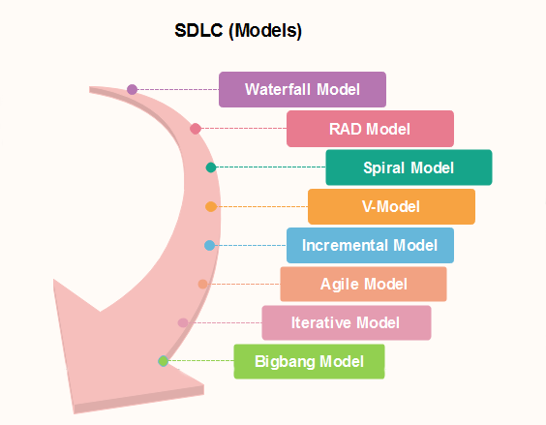
Popular SDLC models

Slide 14
Waterfall Model
What is The Waterfall Model? (Iterative)
Also called classic software life cycle or sequential model or linear-sequential life cycle model
Process activities (phases/stages) are clearly separated
After a number of iterations, phases of the life cycle (such as specification and design) are “frozen”
It was introduced in 1970 by Winston Royce.

Slide 15
Waterfall Model
When to use SDLC Waterfall Model
Waterfall model can be used when
Requirements are not changing frequently
Can be used also for parts of larger software systems
Requirement is clear
Environment is stable
Technology and tools used are not dynamic and is stable
Resources are available and trained
Drawback of the waterfall model
Difficult to incorporate change requests.
Incremental delivery not supported.
Overlapping of phases not supported.
Risk handling not supported.
Limited customer interactions.

Slide 16
Examples of Waterfall Model
Examples of Waterfall Model
In the olden days, Waterfall model was used to develop enterprise applications like
Customer Relationship Management (CRM) systems,
Human Resource Management Systems (HRMS),
Supply Chain Management Systems,
Inventory Management Systems,
Point of Sales (POS)
systems for Retail chains etc.
Waterfall model was used significantly in the development of software till the year 2000. Even after the Agile manifesto was published in 2001, Waterfall model continued to be used by many organization till the last decade.

Slide 17
Examples of Waterfall Model
Examples of Waterfall Model
However, there are some areas where Waterfall model was continued to be preferred.
Consider a system where human life is on the line, where a system failure could result in one or more deaths.
In some countries, such mishaps could lead to imprisonment for those who are accountable.
Consider a system where time and money were secondary considerations and human safety was first.

Slide 18
Rapid application development model (RAD)
Rapid application development model (RAD) is a linear sequential software development process model that emphasizes a concise development cycle using an element based construction approach.
Rapid Application Development process is an adoption of the waterfall model, it targets at developing software in a short span of time.
The Rapid Application Development Model was first proposed by IBM in 1980’s. The critical feature of this model is the use of powerful development tools and techniques.
RAD model has following phases
Business Modeling
Data Modeling
Process Modeling
Application Generation
Testing and Turnover
https://www.guru99.com/what-is-rad-rapid-software-development-model-advantages-disadvantages.html

Slide 19
Rapid application development model (RAD)
1.Business Modelling: The information flow among business functions is defined by answering questions like what data drives the business process, what data is generated, who generates it, where does the information go, who process it and so on.
2. Data Modelling: The data collected from business modeling is refined into a set of data objects (entities) that are needed to support the business. The attributes (character of each entity) are identified, and the relation between these data objects (entities) is defined.
3. Process Modelling: The information object defined in the data modeling phase are transformed to achieve the data flow necessary to implement a business function. Processing descriptions are created for adding, modifying, deleting, or retrieving a data object.
4. Application Generation: Automated tools are used to facilitate construction of the software; even they use the fourth-generation language (4GL) technologies.
5. Testing & Turnover: Many of the programming components have already been tested since RAD emphasis reuse. This reduces the overall testing time. But the new part must be tested, and all interfaces must be fully exercised.

Slide 20
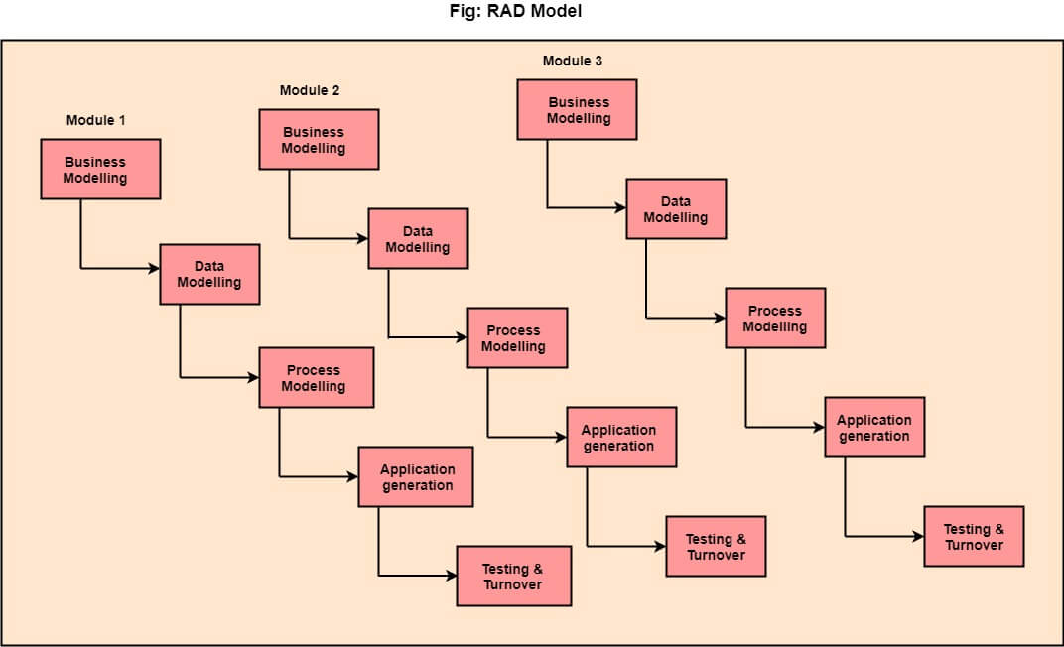
Rapid application development model (RAD)
https://www.javatpoint.com/software-engineering-rapid-application-development-model

Slide 21
Rapid application development model (RAD)
When to use RAD Model?
When the system should need to create the project that modularizes in a short span time (2-3 months).
It is also suitable for projects where requirements can be modularized and reusable components are also available for development.
The model can also be used when already existing system components can be used in developing a new system with minimum changes.
This model can only be used if the teams consist of domain experts. This is because relevant knowledge and ability to use powerful techniques is a necessity.
The model should be chosen when the budget permits the use of automated tools and techniques required.

Slide 22
Rapid application development model (RAD)
Advantage of RAD Model
Use of reusable components helps to reduce the cycle time of the project.
Feedback from the customer is available at initial stages.
Reduced costs as fewer developers are required.
Use of powerful development tools results in better quality products in comparatively shorter time spans.
The progress and development of the project can be measured through the various stages.
It is easier to accommodate changing requirements due to the short iteration time spans.
Disadvantage of RAD Model
It required highly skilled designers.
All application is not compatible with RAD.
For smaller projects, we cannot use the RAD model.
On the high technical risk, it's not suitable.
Required user involvement.

Slide 23
Spiral Model
What is Spiral Model?
Each phase in spiral model begins with a design goal (review) and ends with the client reviewing the progress.
It’s a risk-driven model which means that the overall success of a project highly depends on the risks analysis phase. The spiral model was first mentioned by Barry Boehm in his 1986 paper.
It implements the potential for rapid development of new versions of the software.
The development team in Spiral-SDLC model starts with a small set of requirement and goes through each development phase for those set of requirements.
The software engineering team adds functionality for the additional requirement in every-increasing spirals until the application is ready for the production phase.

Slide 24
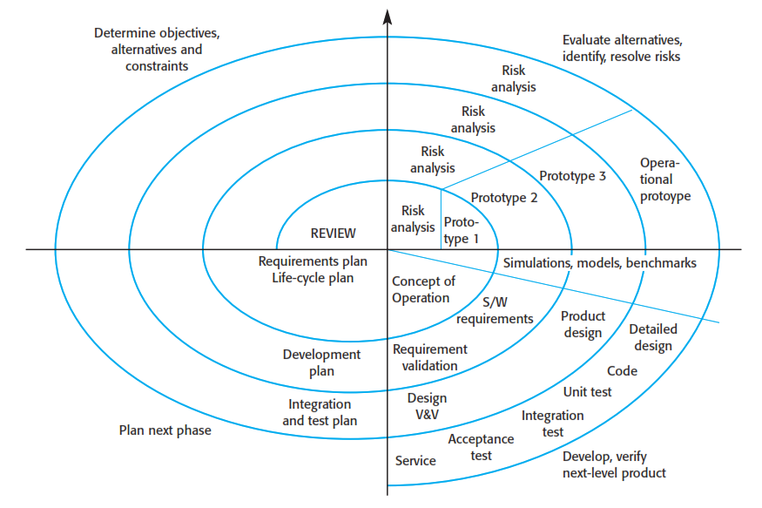
Spiral Model

Slide 25
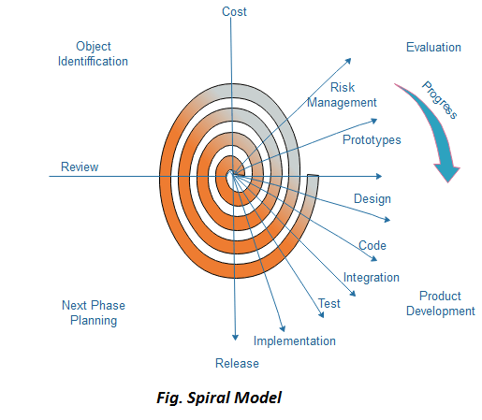
Spiral Model

Slide 26
Spiral Model Sectors
Spiral Model Sectors
Objective setting
Specific objectives for the phase are identified.
Risk assessment and reduction
Risks are assessed and activities put in place to reduce the key risks.
Development and validation
A development model for the system is chosen which can be any of the generic models.
Planning
The project is reviewed and the next phase of the spiral is planned.
https://www.javatpoint.com/software-engineering-spiral-model
https://www.geeksforgeeks.org/software-engineering-spiral-model/

Slide 27
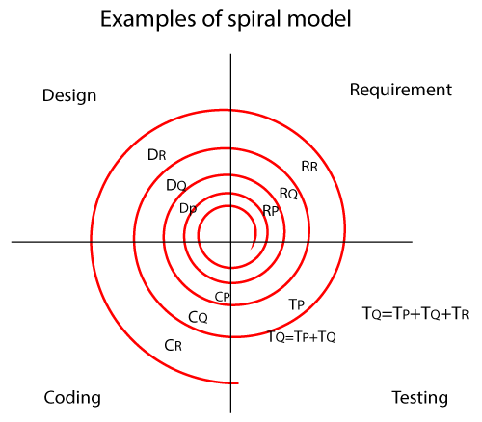
Spiral Model
In the spiral model, the software is developed in the small modules. Suppose we have the application A and this A application is created with the help of different models as P, Q, R.
In the above image,
RP: the requirement analysis of module P, similarly with RQ, RR.
DP: Design of module P, and similarly with DQ, DR.
CP: Coding of module P, and similarly CQ, CR.
TP: Testing of module P, and similarly TQ, TR.

Slide 28
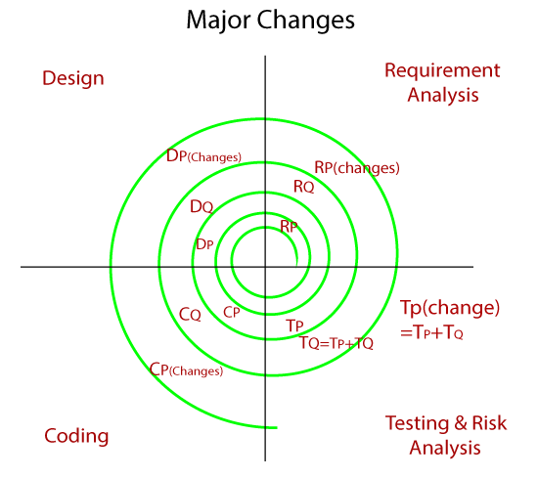
Spiral Model
In the spiral model, we can perform two types of changes, which are as follows:
Major changes
Minor changes

Slide 29
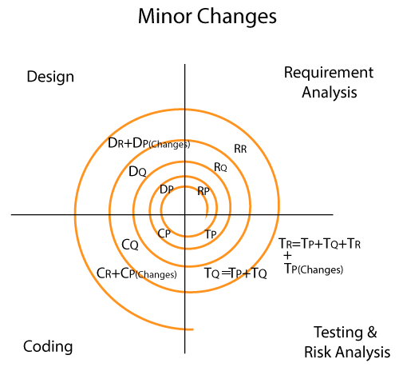
Spiral Model

Slide 30
Spiral Model Sectors
Why Spiral Model is called Meta Model ?
The Spiral model can be viewed as a Meta-model since it subsumes all the initial models.
For example, a single loop spiral represents the waterfall model. The Spiral model uses a prototyping approach by first building a prototype before embarking on the actual product development effort. Also, Spiral model can be considered as supporting the evolutionary model-the iterations along the spiral model can be considered as the evolutionary levels through which the complete system is built. This enables the developer to understand and resolve the risks at each evolutionary level (i.e. iteration along the spiral). The spiral model uses prototyping as a risk reduction mechanism and also retains the systematic step wise approach of the waterfall model.

Slide 31
Spiral Model
When to use Spiral Model?
When deliverance is required to be frequent.
When the project is large
When requirements are unclear and complex
When changes may require at any time
Large and high budget projects
Advantages
Risk Handling
Good for large projects
Flexibility in Requirements
Customer Satisfaction
Disadvantages
Complex
Expensive
Too much dependable on Risk Analysis
Difficulty in time management
https://www.javatpoint.com/software-engineering-spiral-model

Slide 32

Thanks to All

